Slide 1
Green Team
Agile Story
an
House Project Proposal

Slide 2
Long long time ago there existed a team who had no construction knowledge and project managing experience...
They struggled to do even the simplest of tasks...
Then one day a SME, Subject Matter Expert, came and requested the team to develop a virtual house and present their journey to other SMEs.
This is the story of Green Team.

Slide 3
14 memers and a Green... Team...
Green-Team is fantastic group of virtual home developers that is skilled at developing your dream virtual single family home. We aspire to make your future home a greenhouse while, saving you money.
title inspired by David Yirchott
1. Anjali Ghaligi
2. Ghassan Nasr
8. David Yirchott
3. Ezrea Vance
9. Deepti Chaddha
4. Jose Cruz
10. Julia Waclawek
5. David Frary
11. David Holland
6. Christopher Fulton
12. James Covington
7. Emmmanuel Orubele
13. Kyle Burchett
14. Alonso Ninalaya

Slide 4
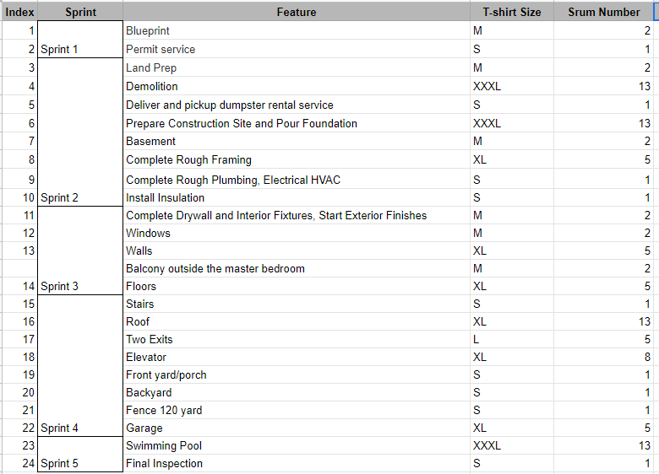
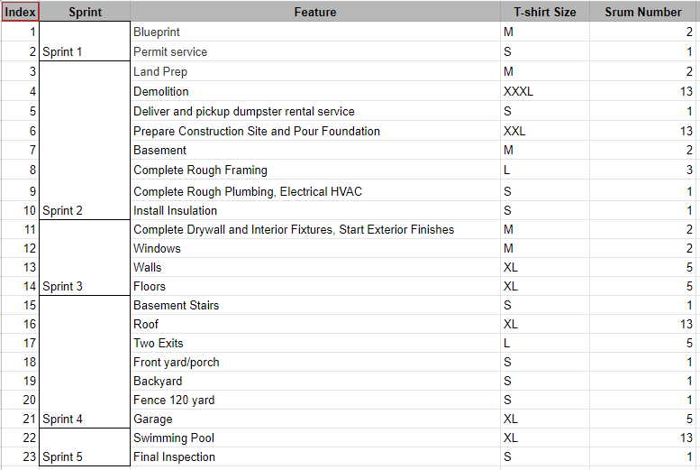
Day 1
being thrown into the fire...
Consisted of...
Meeting with our Project Owner to gather requirements.
Producing a requirement document that included user stories of what PO requested.
1 Story Home Req.
2 Story Home Req.

Slide 5
Day 1 Cont.
Pros: Researching Team Etiquette Team Bonding
Cons: Every feature was an EPIC Planned all of our sprints AOT, ahead of time. Didn’t fully understand project requirements.

Slide 6
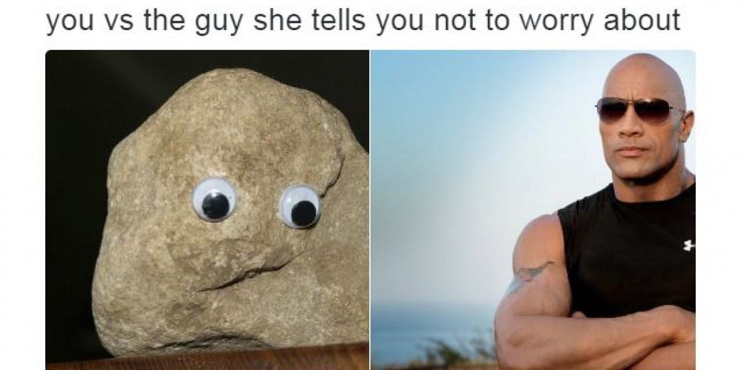
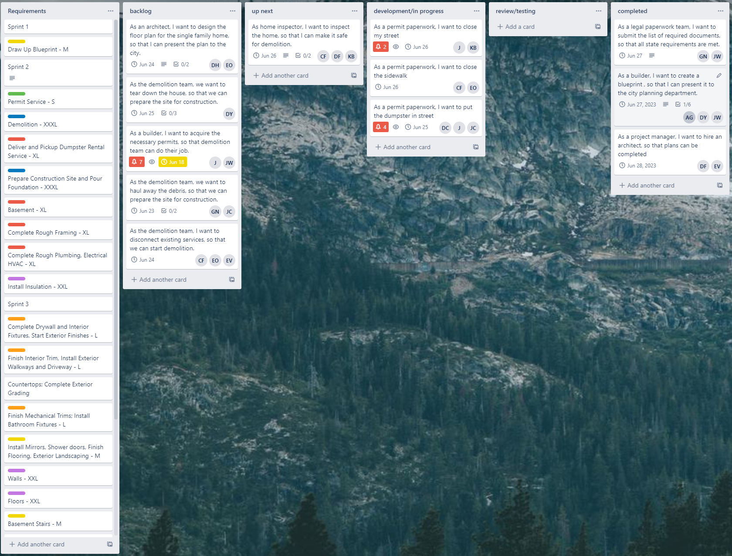
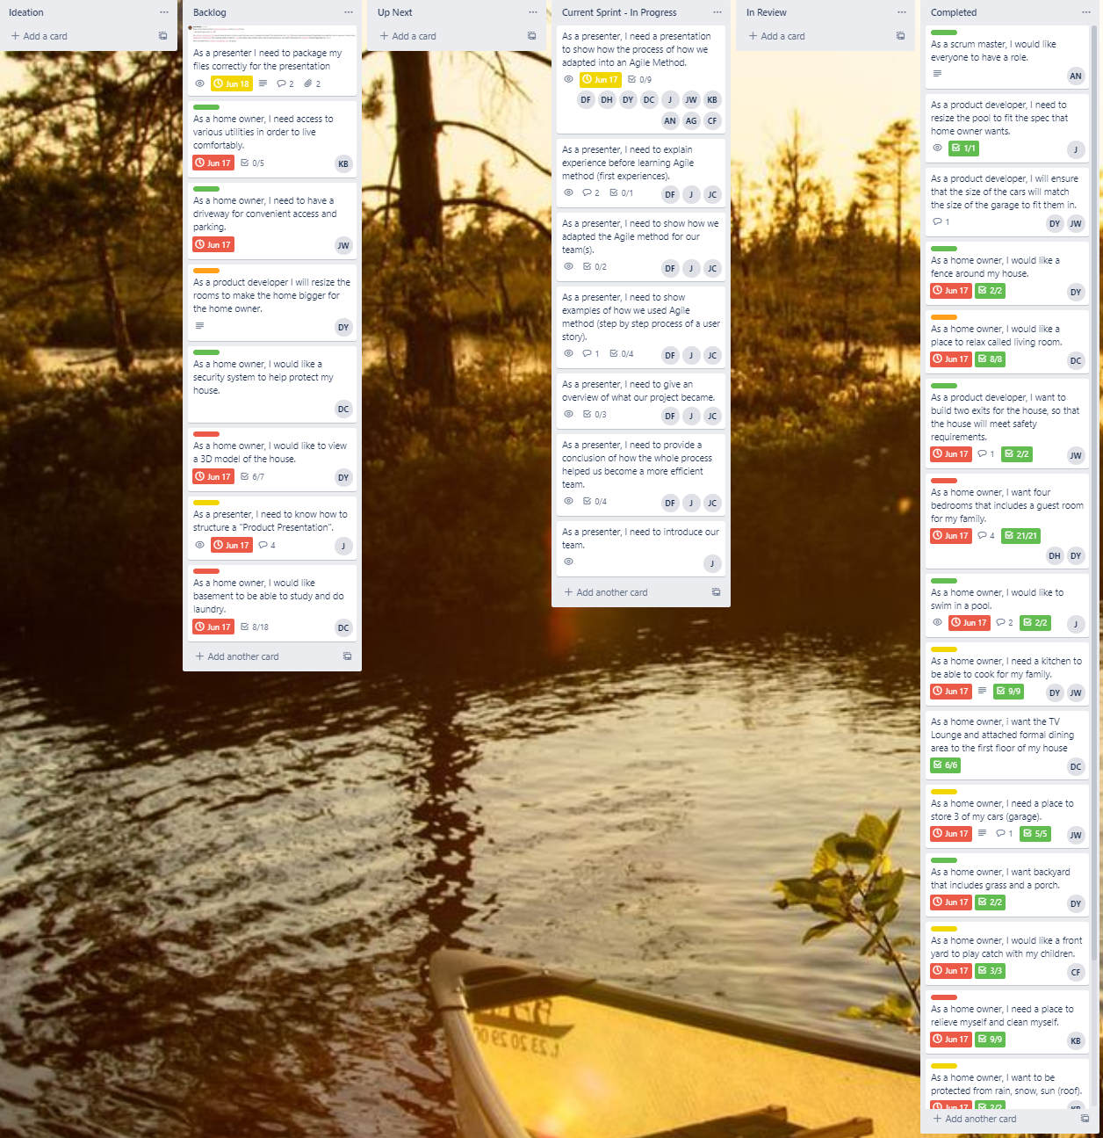
Day 2
converting epic into a board...
Task
How a Zoomer could relate to such a board...
Put our requirement document on a Trello board representing an Agile way of things.

Slide 7
Day 2 Cont.
Pros: Realized all our features were EPICs rather than user stories. Were able to convert EPICs into user stories. Took advantage of Trello by implementing tasks, due dates, and other various tools for each user story.
Cons: Included all our EPICs. Planned out all our sprints ahead of time again. Didn’t properly take advantage of Agile. Had couple bottlenecks that left most team not working.

Slide 8

Day 2.5
starting over...
After Break:
Leon made it very clear what the project was about, making a virtual house and presenting the process to SME of Agile Methodology.
He suggested that we start a new board and to focus on really converting epics into user stories.
Also at the end of the day we lost one of our house planners.

Slide 9
Day 3
redemption arch...
We started the day off right by performing a retrospective session…
What went well?
What went poorly?
What would you improve?

Slide 10
01
About the Project

Slide 11
Now
Venus has a beautiful name and is the second planet from the Sun. It’s terribly hot and its atmosphere is extremely poisonous

Slide 12
Project Goals
Goal 1
Goal 2
Goal 3
Goal 4
Work with the client in order to tailor the home to his needs and desires. .
Develop a plan to build the house using SCRUM.
While utilizing the AGILE methodology we continuously monitored the projects development to adjust our workflow.
Have the client be satisfied with the completed project.

Slide 13
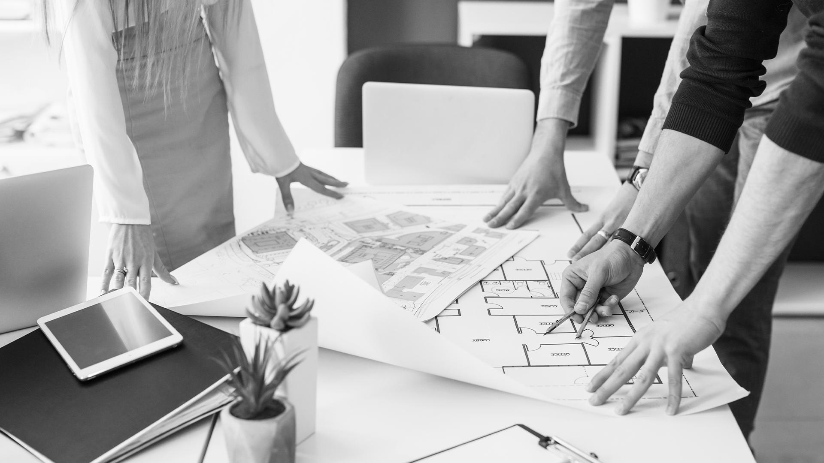
A Picture Is Worth a Thousand Words

Slide 14
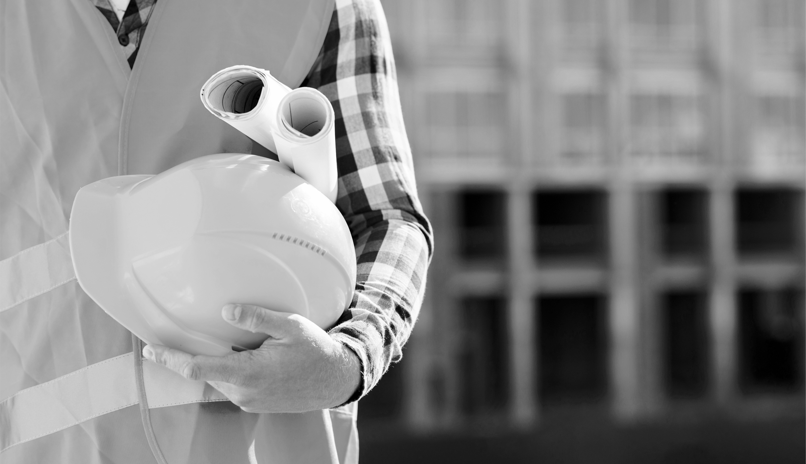
Sneak Peek
Insert your multimedia content here

Slide 15
Project Stages
Stage 3
Stage 2
Stage 1
Venus is the second planet from the Sun
Neptune is the farthest planet from the Sun
Mercury is the closest planet to the Sun
Notes:
Not necessary

Slide 16
Thanks!
Do you have any questions? youremail@freepik.com +91 620 421 838
yourcompany.com
Please keep this slide for attribution.

Slide 17
Overview
This is a beautiful 4 room and bath home in the wonderful location of Long island New York.
Notes:
Rough draft of information for 1 story building

Slide 18
Interior Information
4 bedrooms
4 bathroom
Furnished Basement
Wooden floor
Tv Lounge
Gallery (optional)
Back porch (optional)
Front porch (optional)
Smart kitchen
Walk-in Pantry
Drop down stairs to attic

Slide 19
Exterior Information
Fencing around 90 yards.
Swimming pool
Backyard
Dark brown roofs
Brick wall
Balcony (optional)
3 car garage

Slide 20
Utilities
Solar energy
Natural gas
City water
Central heat
Central air
City backup electric grid (optional)
Wifi and Smart home
Security system

Slide 21
Property type
1 Story building
????? SQFT

Slide 22
2 Story building

